Slide 1
4-Bit Synchronous Up/Down Counter
with Seven-Segment Display
Design and Simulation • Project Batch 17
PRESENTED BY:
1.2620090046-DAIVANSH
2.2620090074-SUSHANTH
3.2620090112-RAGHURAM
4.2620090123-HARSHITHA

Slide 2
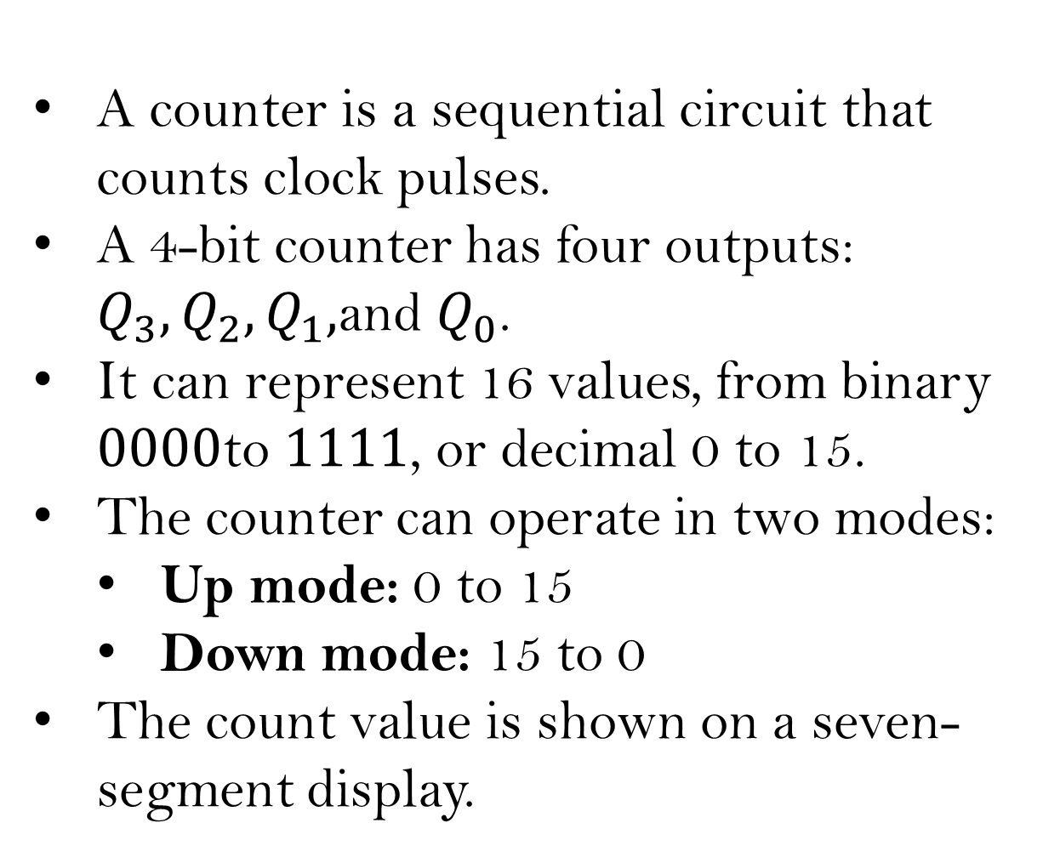
INTRODUCTION ABOUT THE PROJECT:
A counter is a sequential circuit that counts clock pulses.
A 4-bit counter has four outputs: $Q_{3},Q_{2},Q_{1},$and $Q_{0}$.
It can represent 16 values, from binary $0000$to $1111$, or decimal 0 to 15.
The counter can operate in two modes:
  Up mode: 0 to 15
  Down mode: 15 to 0
The count value is shown on a seven-segment display.
Clock
↓
Counter
↓
Display

Slide 3
Main Concept
Clock = WHEN • Up/Down = WHICH WAY • Synchronous = TOGETHER
Clock — When to Count
The clock sends repeated pulses.
One pulse = one change in the count.
0 → 1 → 2 → 3
Up/Down — Direction
A switch decides whether the counter increases or decreases.
UP: 1 → 2 → 3
DOWN: 3 → 2 → 1
Synchronous — Together
All four flip-flops use the same clock signal and work together.
Same clock → all flip-flops

Slide 4
How the 4-Bit Counter Works
Synchronous Up/Down Counter
In a synchronous counter, all flip-flops receive the same
clock signal.
The outputs change together at the active clock edge.
A mode-control input selects the counting direction:
Counting Sequence
Up counting: 0000, 0001, 0010, 0011, ..., 1111
Down counting: 1111, 1110, 1101, 1100, ..., 0000
A common clock makes the counter faster and avoids the delay associated with ripple counters.
Q3
Q2
Q1
Q0
0
1
0
1
Mode Input | Operation
1 | Up counting
0 | Down counting
0101₂ = 5₁₀

Slide 5
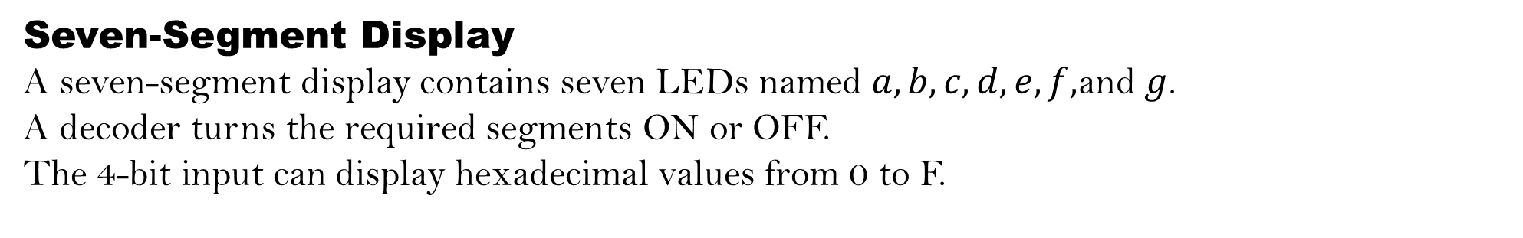
Seven-Segment Display
A seven-segment display contains seven LEDs named $a,b,c,d,e,f,$and $g$.
A decoder turns the required segments ON or OFF.
The 4-bit input can display hexadecimal values from 0 to F.
inary Input | Display
0000 | 0
0001 | 1
0010 | 2
1001 | 9
1010 | A
1111 | F
The decoder has four input lines and seven output lines.
Each output line controls one segment of the display.

Slide 6
Block Diagram & Working
UP / DOWN
↓
Clock
4-Bit
Up/Down Counter
4to7 segment
Decoder
7-Segment
Display
Q3,Q2,Q1,Q0
Circuit Operation
The clock produces regular pulses.
The four flip-flops store the current count.
Logic gates decide whether the next count is higher or lower.
The decoder converts the 4-bit output into seven segment signals.
The display shows the current count value.
.

Slide 7
Problem Statement
Manual observation of binary counter outputs using LEDs can be difficult.
In an asynchronous counter, output changes may occur at slightly different times because of propagation delay.
A simple circuit is required to:
  Count in both upward and downward directions.
  Change all flip-flop outputs at the same clock edge.
  Display the count in an easy-to-read format.
  Verify the design through simulation.
Problem Definition
To design and simulate a 4-bit synchronous binary up/down counter in Logisim and display its output using a seven-segment display.

Slide 8
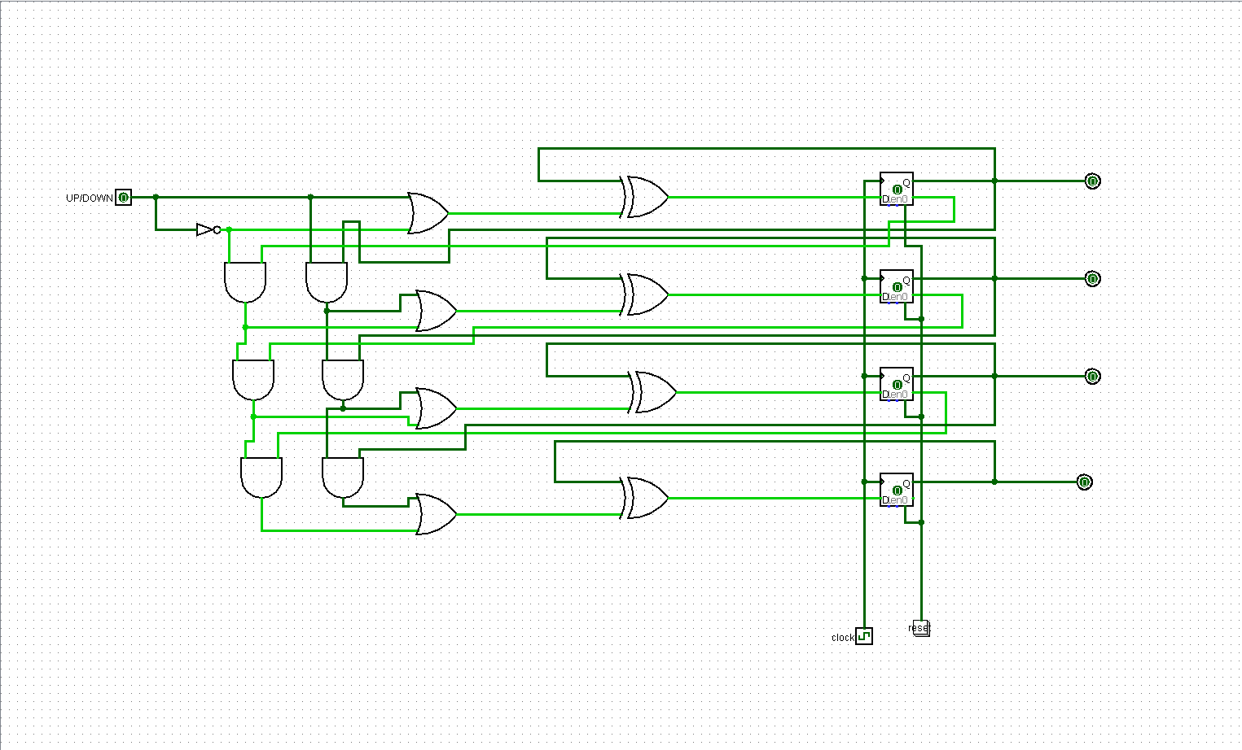
Applications & logisim
Simulation Steps
Connect four flip-flops to a common clock.
Add the up/down control switch.
Connect the counter outputs to the seven-segment decoder.
Apply the reset signal to start at 0000.
Select up mode and apply clock pulses.
Observe the display counting from 0 to F.
Select down mode and observe the display counting from F to 0.

Slide 9
CONCLUSION
This project shows how clock signals, flip-flops, binary counting and a seven-segment display work together to create a simple digital counting system.
Clock → Count → Display

Slide 10
THANK YOU

